Slide 2
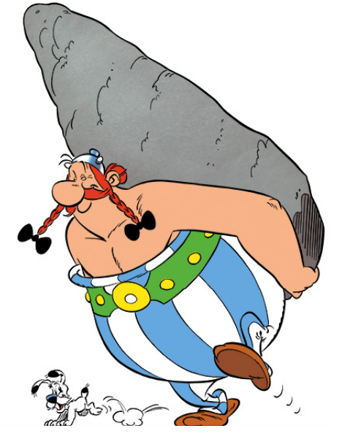
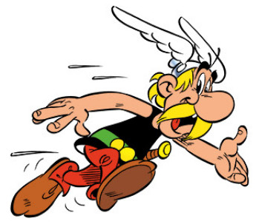

Slide 3


Slide 4
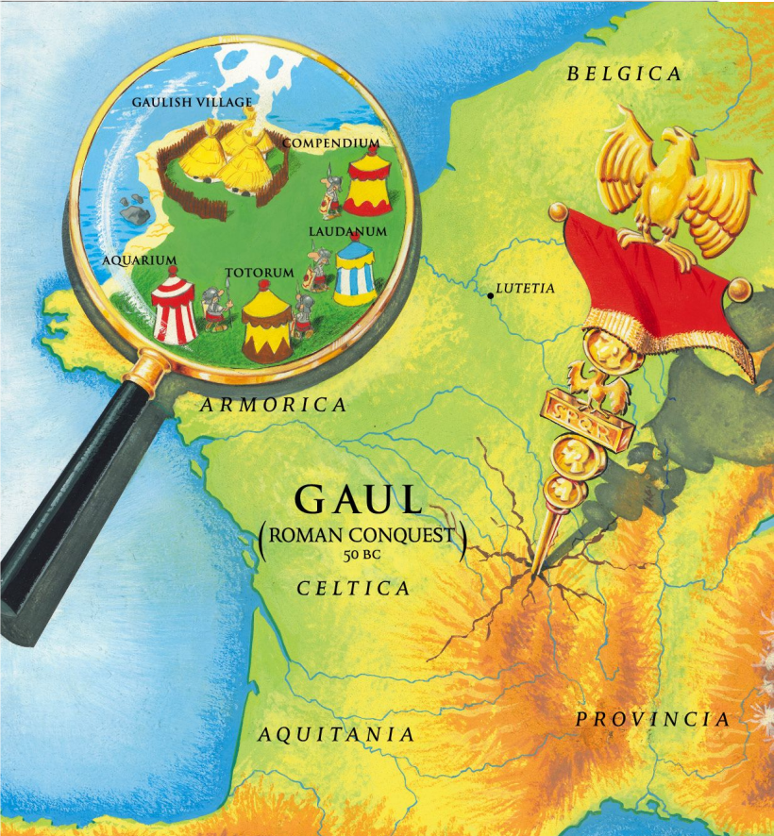

Slide 6
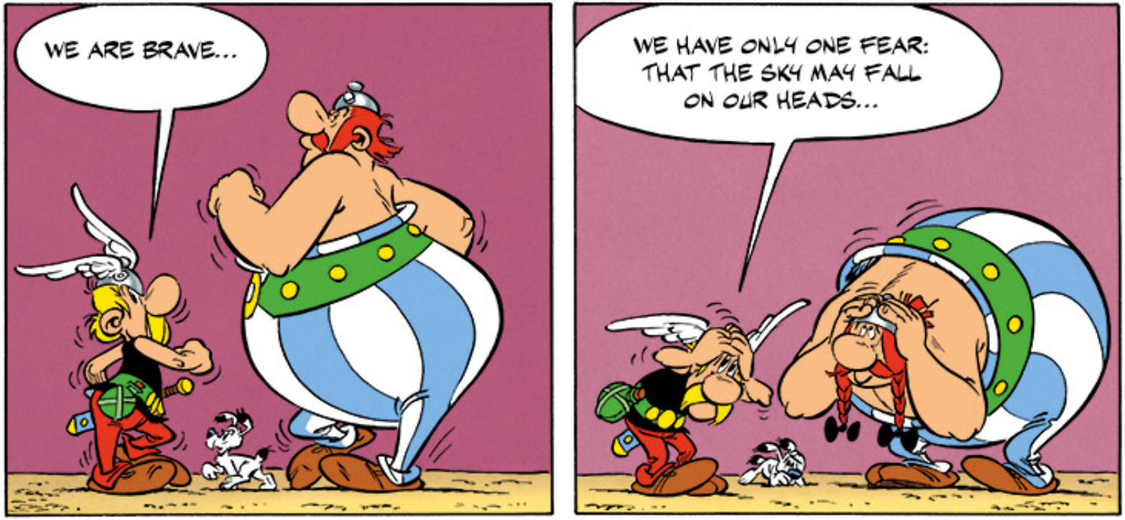

Slide 8
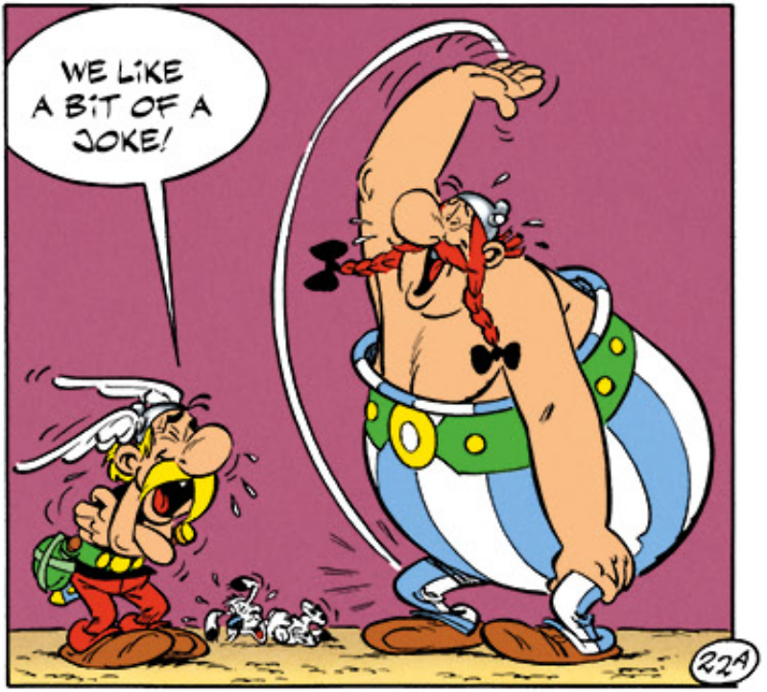

Slide 10
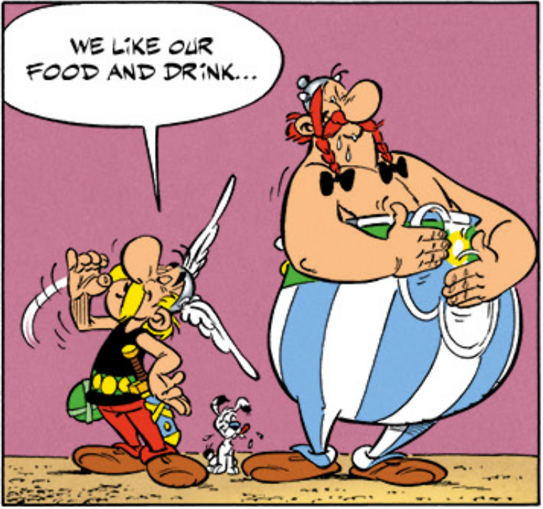

Slide 12
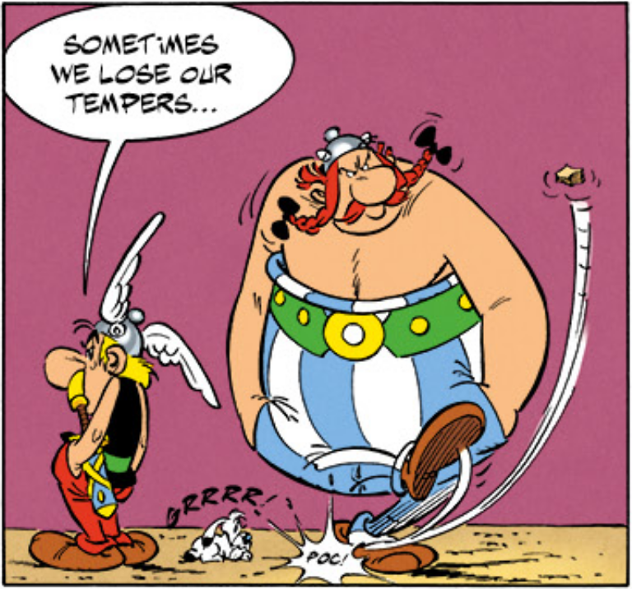

Slide 14
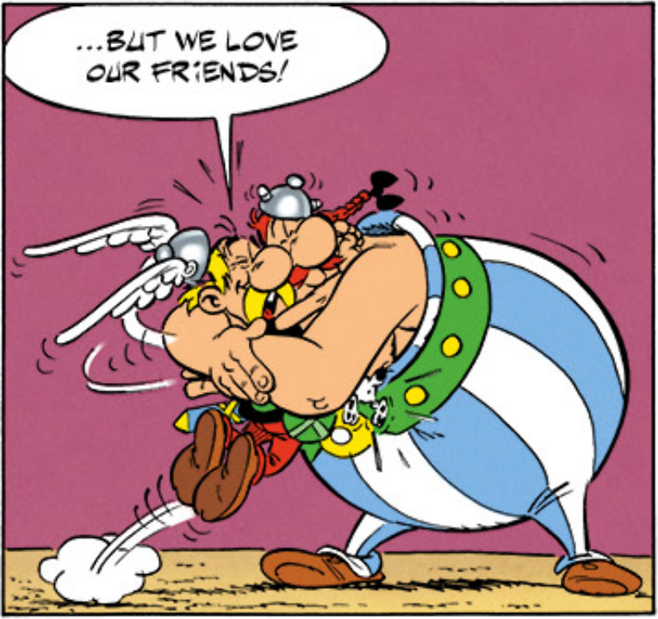

Slide 16
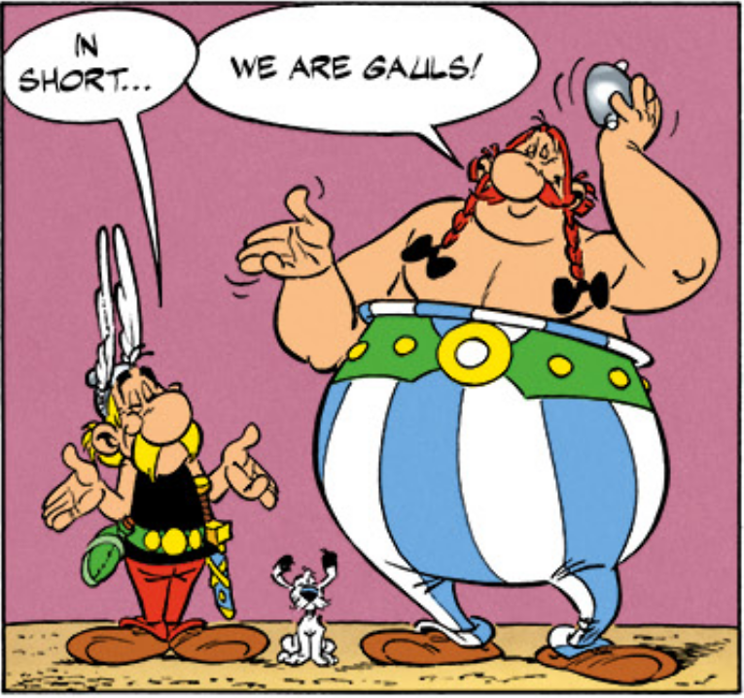

Slide 17
Brave
Likes a joke
Likes food and drink
Sometimes loses temper
Loves friends

Slide 18
Brave
Likes a joke
Likes food and drink
Sometimes loses temper
Loves friends
GAUL

Slide 19
How do you recognise a Christian?

Slide 20
“God did not give us a spirit that makes us afraid. He gave us a spirit of
power and love and self-control.
So do not be ashamed to tell people about our Lord Jesus… but suffer with me for the Good News. God gives us the strength to do that.”
2 Timothy 1:7-8

